Slide 1
Project 1 - Team Uber
MSiA 400 - Everything Starts With Data
Yiwei Zhang
Arpan Venugopal
Molly Srour
Kejin (Karen) Qian
Elliot Gardner

Slide 2
Introduction
- Focused on Healthcare Vertical
- Looked at Nursing Assistant and Nurse Manager roles because they offered the largest data set for nurse-related jobs
- Conducted analysis of the dataset using a number of approaches:
Correlation of various variables with time to fill (size of state, month of posting, salary)
Inter-category tags comparisons (education, experience level, shift, etc)
Urban vs rural county comparisons
Regional comparisons
Predicting “successful job fills” based on available variables

Slide 3
Assumptions/Limitations
- Empty “time to fill” - Posting not filled or erroneous information
- Short “time to fill” (under 7 days) - Posting filled by other means, not relevant to analysis
- Long “time to fill” (over 90 days) - Posting not tied to specific position, not relevant to analysis
- Time to fill was the most meaningful indication of demand for a position from an employer’s standpoint

Slide 4
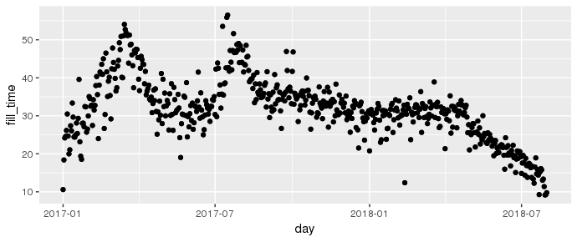
Exploratory Data Analysis
- We had 222691 and 50728 observations of Nursing Assistant and Nurse Manager initially
- 3.30% did not have time to fill data
- 4.21% did not have location data
- No immediate correlations between salary and time to fill
- Interesting patterns in time to fills vs
time, but ultimately the product of data
gathering techniques rather than actual
periodicity in the job market

Slide 5
Factors vs Time to Fill
- Individual factors (posting month, year, state, salary) all have very low correlations with time to fill (below 0.1)
- Need to look at location and time together - if subset by posting month/year and state, salary has high correlations with time to fill (around 0.5)
- Different roles should be studies separately - very different correlations
- Number of job posts as potential mediating factor

Slide 6
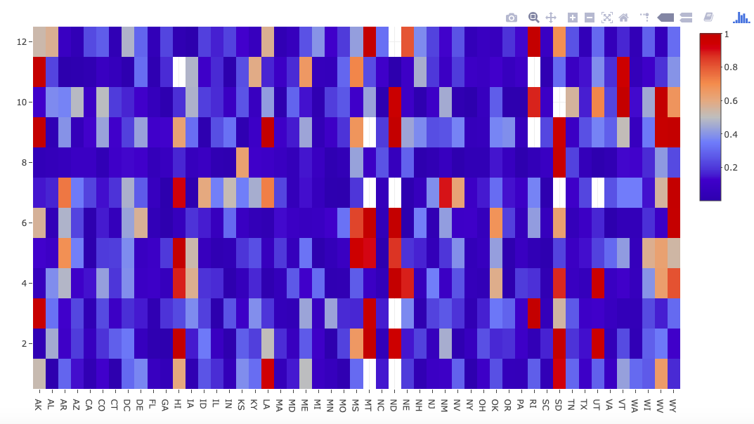
Factor vs Time to Fill - State and Time
The correlation between salary and time to fill is extremely high in some state during certain months, but not as much during other time of the year
Notes:
Absolute value of the correlation

Slide 7
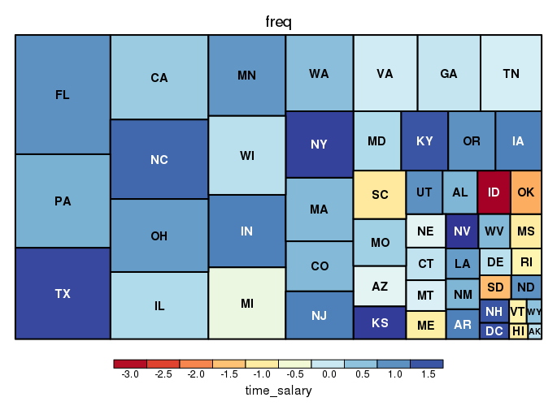
Factor vs Time to Fill - Number of Posts
States with more job postings also have higher correlation between salary and time to fill, compared to states with less job postings
Notes:
Size: number of jobs posted in the time frame
Color: correlation between time and salary as shown in the color scale

Slide 8
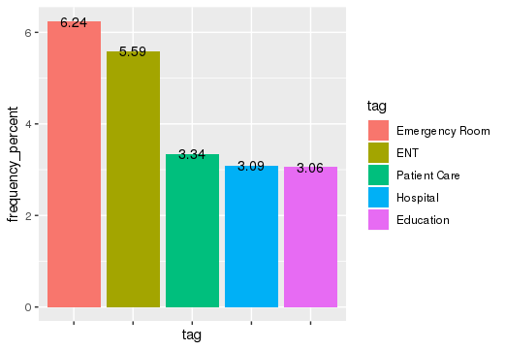
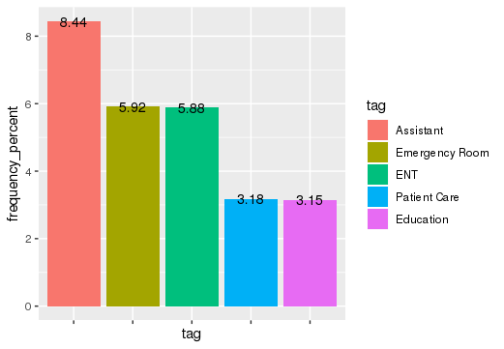
Tags Analysis
Nurse Manager
Nursing Assistant
The top 5 tags each for Nurse Manager and Nursing Assistant account for 20% of the total tags associated with the job postings for each role

Slide 9
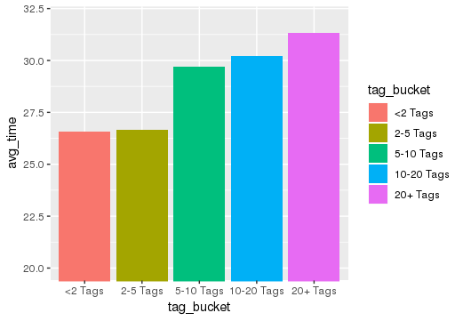
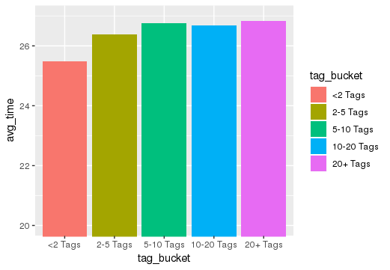
Tags Analysis
Nurse Manager
Nursing Assistant
For both Nurse Manager & Nursing Assistant, average time to fill increases with #tags associated with the job post

Slide 10
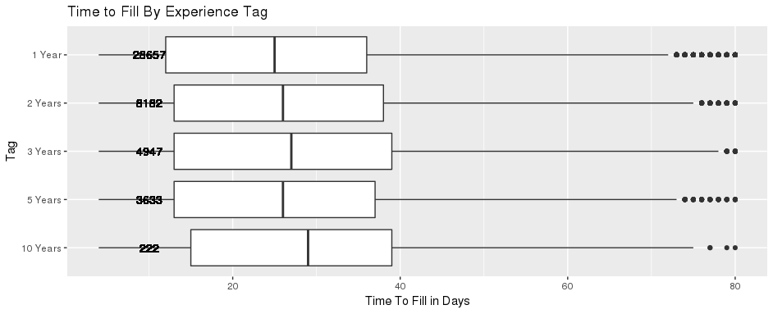
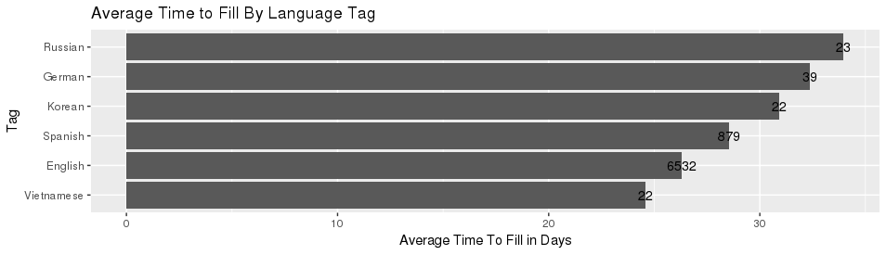
Tags Analysis
- Split the tags into groups of related tags (guesswork, by hand)
- Examined average time to fill for tags within the same set (language skills, shift listed, education mentioned, department listed, years of experience)
-Differences were often, but not always, statistically significant

Slide 11
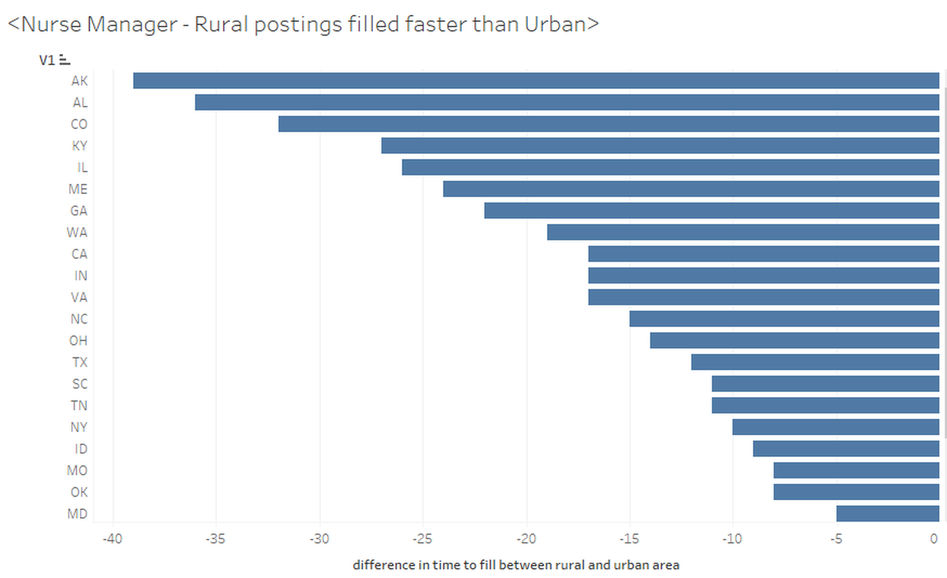
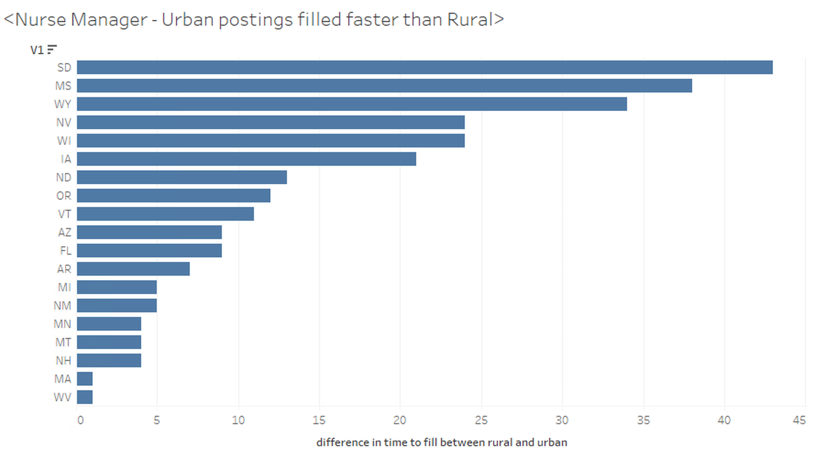
Urban/Rural vs Time to Fill - Nurse Manager
In these states, Nurse Manager positions were filled faster on average in rural counties
In these states, Nurse Manager positions were filled faster on average in urban counties

Slide 12
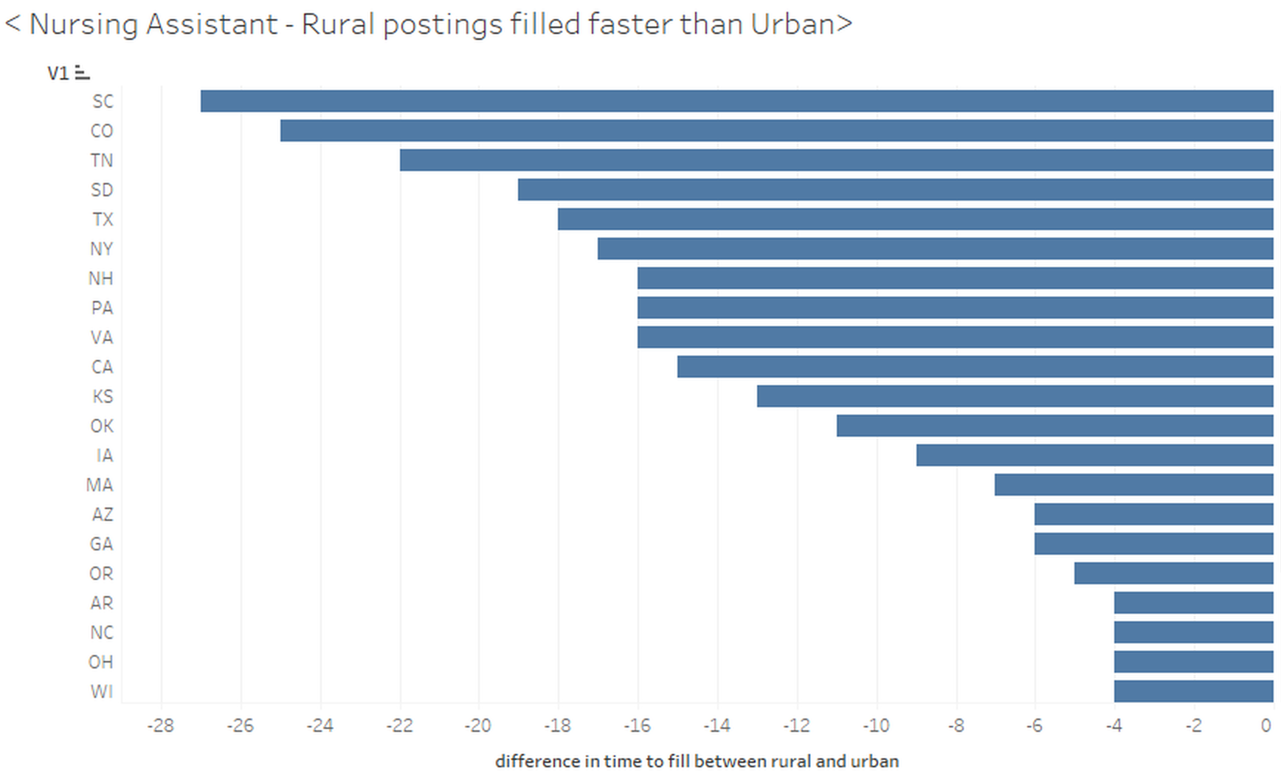
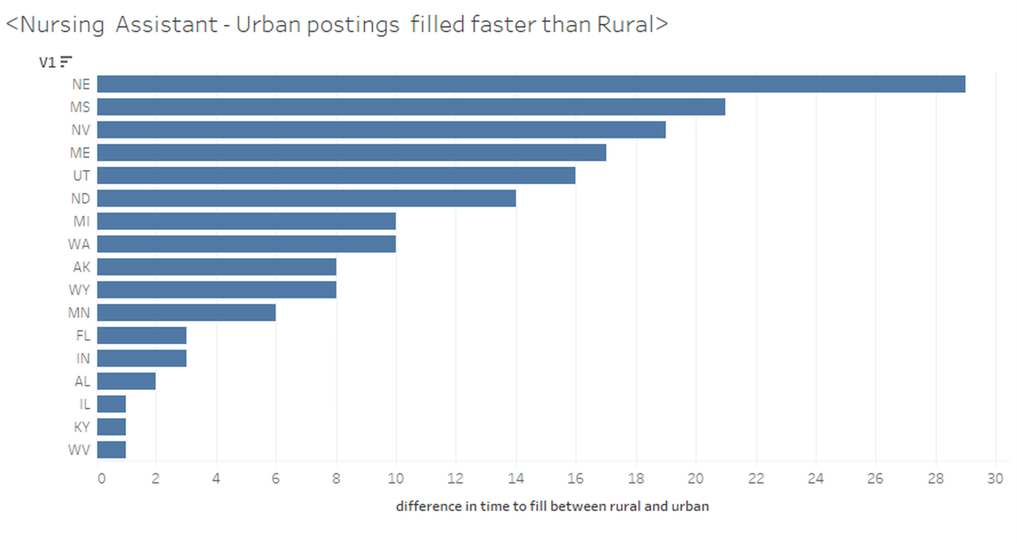
Urban/Rural vs Time to Fill - Nursing Assistant
In these states, Nursing Assistant positions were filled faster on average in rural counties
In these states, Nursing Assistant positions were filled faster on average in urban counties

Slide 13
Rural/Urban Analysis
- For Nursing Assistants, the difference in mean of time-to-fill between rural and urban counties is statistically significant (0.381703, 1.234361) with p-value 0.0002824, so Nursing Assistant roles were filled faster in urban counties
- For Nursing Manager, the difference in mean of time-to-fill between rural and urban counties is actually not significant
- The salary of Nursing Assistant in urban counties is 4.6% higher than the salary of Nursing Assistant in rural counties
- The salary of Nurse Manager in urban counties is 8.1% higher compared to the salary in rural counties

Slide 14
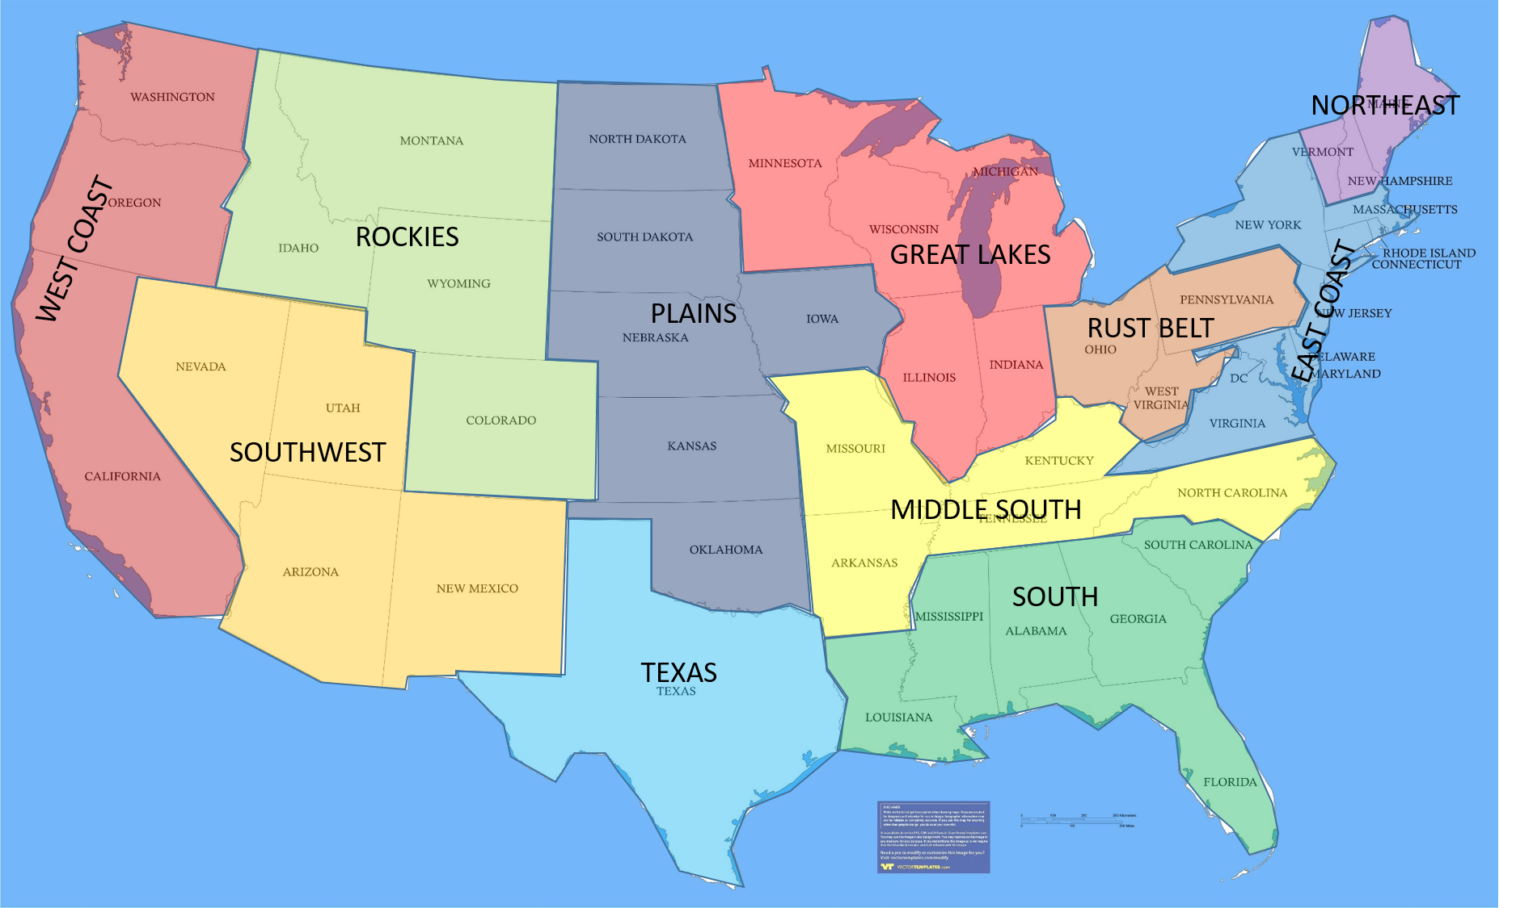
Regional Analysis
- Identified classic regional definitions of the US
- Computed Moran’s Index on the average time to fill per state when using distance between states versus being in the same region
Moran’s Index for States by Distance: 0.07, p-value: 0.002
Moran’s Index for States by Region: 0.262, p-value: 0.005
- Found that regional groupings provided higher measure of spatial auto-correlation than distance between states did
- Looked at average time to fill per region and per role, with statistically significant differences found in the majority of cases

Slide 15
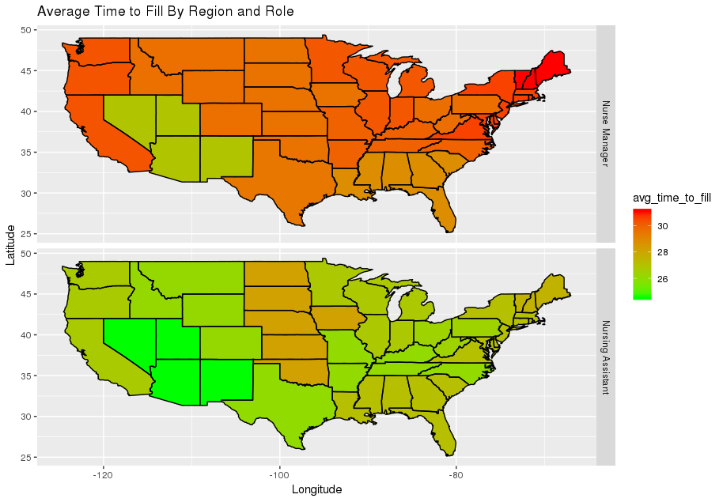
Regional Analysis Results
Harder to Fill
Easier to Fill

Slide 16
Logistic Model
- Removed outliers based on quantiles (time to fill above 90th quantile and below 10th quantile)
- Binary flag response variable: 1 if time to fill is below the median value, 0 otherwise
- Separated by role (two separate logistic models)
- Divided into train and test and included all created variables from above analysis
- Eliminated non-significant predictors

Slide 17
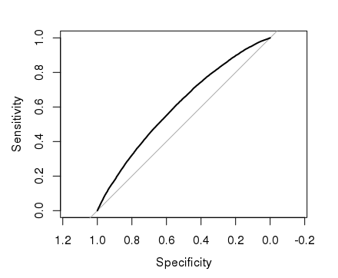
“Successful” Job Fill Logistic Model (Nursing Assistant)
Significant Predictors : Post Month, Region, salary, #Tags, tf-idf values (Emergency, Veteran, Work.Weekend, Assisted.Living)
Classified / Predicted
 | Not Successful | Successful
Not Successful | 10587 | 9179
Successful | 7395 | 12033
Actual
Precision : 0.57
Recall : 0.62
F1-Score : 0.59
AUC : 0.61

Slide 18
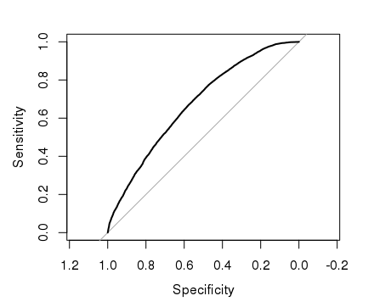
“Successful” Job Fill Logistic Model (Nurse Manager)
Significant Predictors : Post Month, Region, salary, #Tags, tf-idf values(Critical Care, Discharge planning, Computer skills)
Classified / Predicted
 | Not Successful | Successful
Not Successful | 2395 | 1997
Successful | 1291 | 2869
Actual
Precision : 0.59
Recall : 0.69
F1-Score : 0.64
AUC : 0.67

Slide 19
Summary/Conclusions
- First Goal: Identify factors that correlate with demand
Rural vs urban postings fill differently depending on state
For jobs in the same state and month of posting, salary sometimes correlates to time to fill (but not always)
Larger market in a state increases the correlation of high salary jobs to time to fill
We can identify that certain preferred languages, experience levels, education levels can make a job faster or slower to fill
When comparing jobs based on regions, Nurse Manager jobs fill slower than Nursing Assistant, but the regions where it is easier or harder to fill a role differ per role

Slide 20
Summary/Conclusions
- Second Goal: Help Greenwich provide valuable consulting to companies
By examining which factors tend to increase or decrease average time to fill, Greenwich can help employers focus their energies on filling jobs that are more likely to fill slowly
Greenwich can provide expert knowledge on historical trends for job demand broken down by a variety of factors
Using a logistic model that predicts success or failure in filling a job (filled in 30 days or less), we can combine these important factors into an overall prediction tool that Greenwich can use to advise companies on where to focus their energies

